Slide 1
BAN-620 DATA MINING FINAL PROJECT
Team Members:
Niveditha Kumarasamy sb3893 Shruti Joshi jd4923 Suchitra Venkatesan qw9684 Vani Joshi eu2388

Slide 2
1. DATA EXPLORATION
The dataset contains approximately 12,000 commercially available wines.
The variables are mostly related to the chemical properties of the wine being sold.
The goal of this project is to predict the number of wine cases that will be sold given certain properties of the wine.
This is done by exploring the various features in the dataset, cleaning the data and employing some analytical tools and techniques to develop models.
The model that will best predict the wine sales is chosen.

Slide 3
The work is carried out in four different stages :
Data Exploration - Data is cleaned, scaled and analyzed
Data Preparation - Analyzing correlation between wine properties & deciding the ones that contribute the most towards sales.
Building Models - Developing different models to best predict the wine sales based on properties.
Model Selection - Selecting the model with least error and low implementation cost

Slide 4
Initial observations:
The categorical features, STARS and LabelAppeal seem to vary proportionally with the TARGET over the entire range :
STARS : seems to be logically the most valuable variable for indicating desire for purchase.
4 Stars = Excellent
1 Star = Poor
A high number of STARS suggests higher number of sales (TARGET).
LabelAppeal : Marketing Score indicating the appeal of label design for consumers.
High numbers suggest customers like the label design.
Higher numbers suggest better sales.

Slide 5
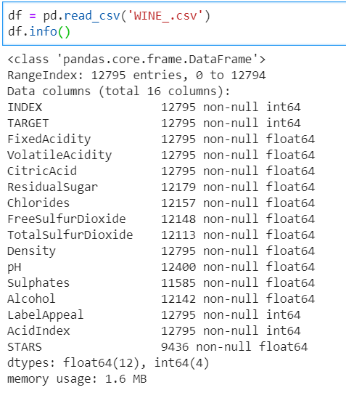
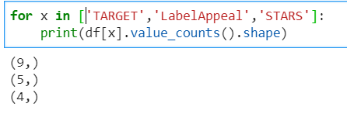
A priliminary scan of the data indicates a lot of missing values for the features.
The STARS feature in particular has the majority of data missing(26.25%).
Number of unique values in STARS, LabelAppeal and TARGET :
5 different types of Label Appeal values and 4 types of STAR ratings for the data.
Lower STAR rating results in lesser number of wine TARGETS being sampled. Hence, the missing values have been imputed as 0 for STARS.

Slide 6
Scatter Plot :
The Scatter plots indicate that lower Label Appeal implies lesser number of TARGET samples.
The plot of TARGEt vs STARS show greater the STAR rating, higher the number of TARGET samples sold
The scatter plots also indicate that there is no correlation between features like Citric Acid, Acid content, Fixed Acidity etc.
The plots do not show any outlier for the features

Slide 7
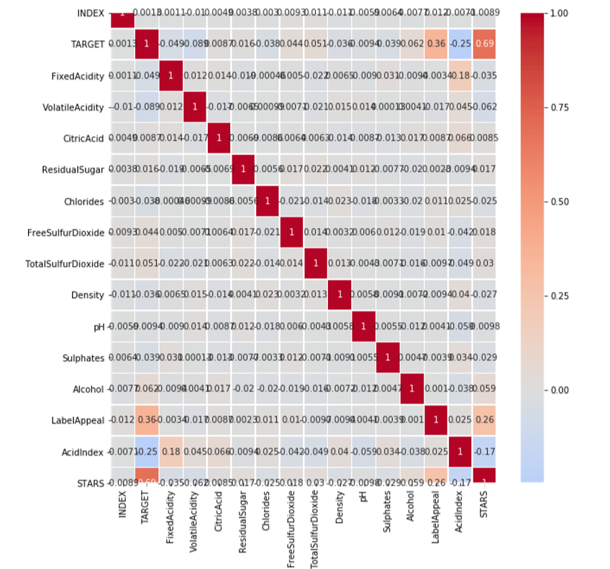
Heat Map :
Strong positive correlation between TARGET and (LabelAppeal & STARS)
Strong negative correlation between TARGET and AcidIndex

